Slide 1
Linear relationships
EQ – How do I find the equation of a linear graph?
Mrs James
Year 10

Slide 2

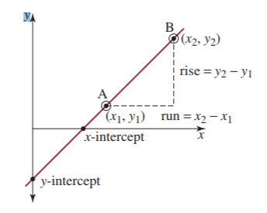
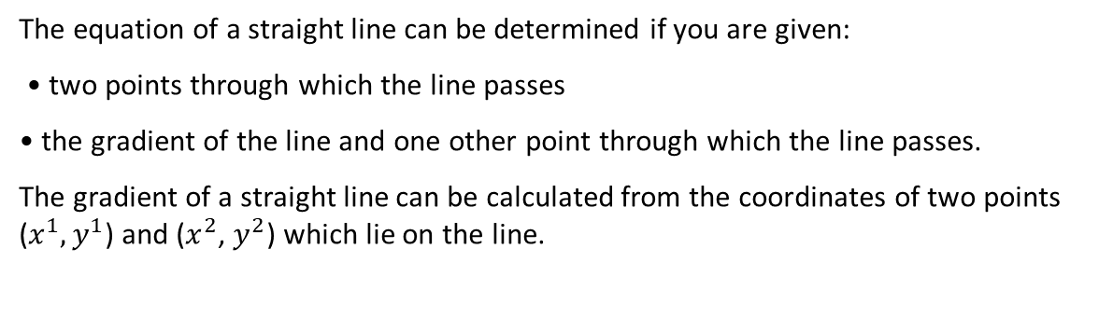
24
7
30
Date
Linear relationships
EQ – How do I find the equation of a linear graph?
The equation of a straight line can be determined if you are given:
• two points through which the line passes
• the gradient of the line and one other point through which the line passes.
The gradient of a straight line can be calculated from the coordinates of two points ($x^{1},y^{1}$) and ($x^{2}$, $y^{2}$) which lie on the line.
Notes:
Input

Slide 3
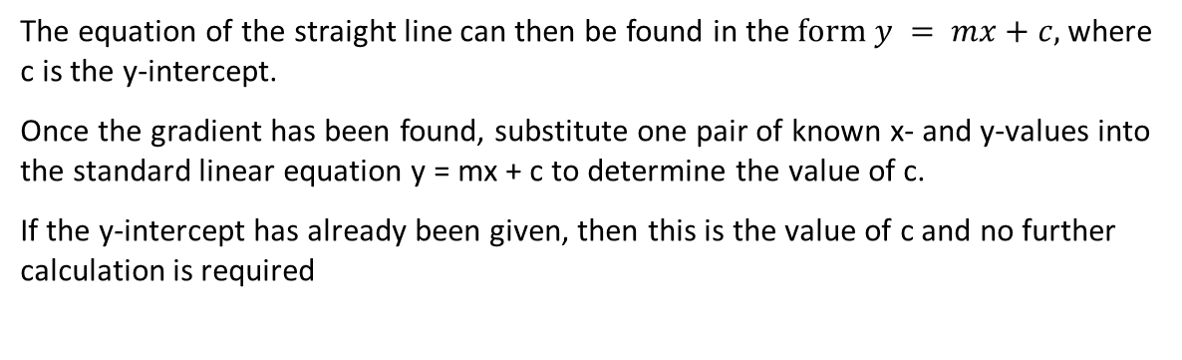
24
7
30
Date
Linear relationships
EQ – How do I find the equation of a linear graph?
The equation of the straight line can then be found in the $form y = mx+c,$where c is the y-intercept.
Once the gradient has been found, substitute one pair of known x- and y-values into the standard linear equation y = mx + c to determine the value of c.
If the y-intercept has already been given, then this is the value of c and no further calculation is required
Notes:
Input

Slide 4
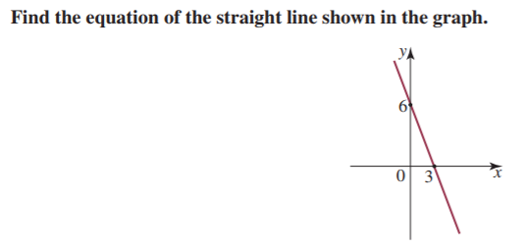
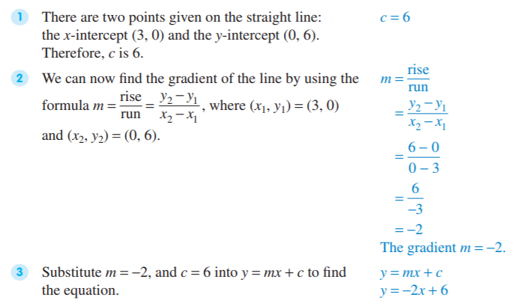
Example 1: We will do this together. Complete this in your Interactive notebook

Slide 5

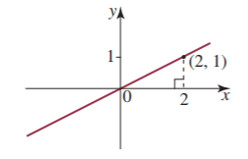
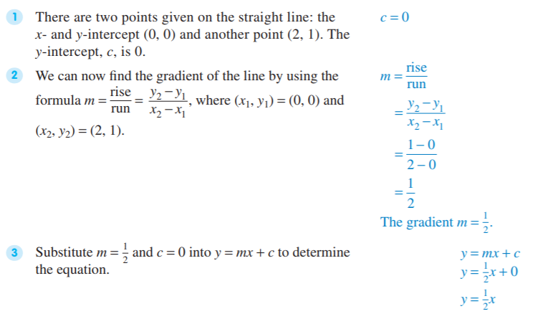
Example 2: This is where you will need to work independently. GIVE YOUR 100%

Slide 6
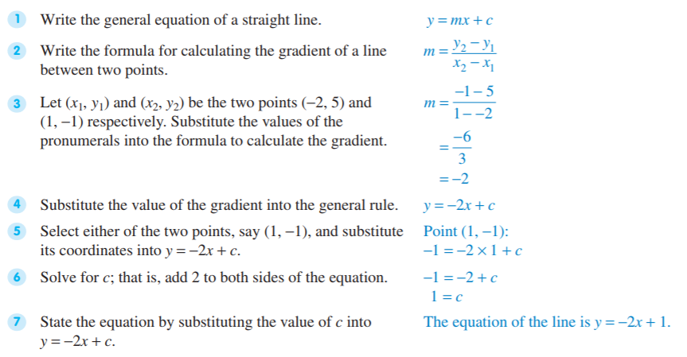
Example 3: We will do this together. Complete this in your Interactive notebook
Find the equation of the straight line passing through (-2, 5) and (1, -1).

Slide 7
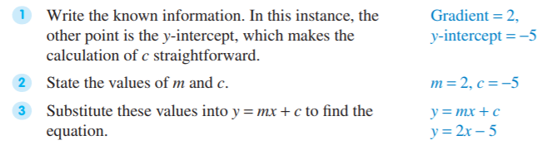
Example 4: We will do this together. Complete this in your Interactive notebook
Sometimes you can find the equation of a straight line using the gradient and another point. This is called the point–gradient method.
Find the equation of the straight line with gradient of 2 and y-intercept of -5.

Slide 8
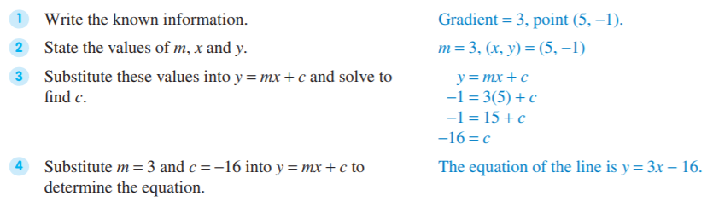
Example 5: We will do this together. Complete this in your Interactive notebook
Sometimes the gradient and another point which is not the y-intercept is given. The value of c can then be found by substituting the coordinates of this point $into y = mx + c.$
Find the equation of the straight line passing through the point (5, -1) with a gradient of 3.

Slide 9
Your turn to practice
Complete the following worksheets:
Determining linear equations Worksheet 1(easiest)
Linear equations Worksheet 2(moderate)
More complex linear equations Worksheet 3(challenging)
These worksheets will be on CONNECT along with this PowerPoint to support your revision and study of this topic.
Homework/Revision
Continue to work through the worksheets above
Write your summary of this topic

